Slide 1
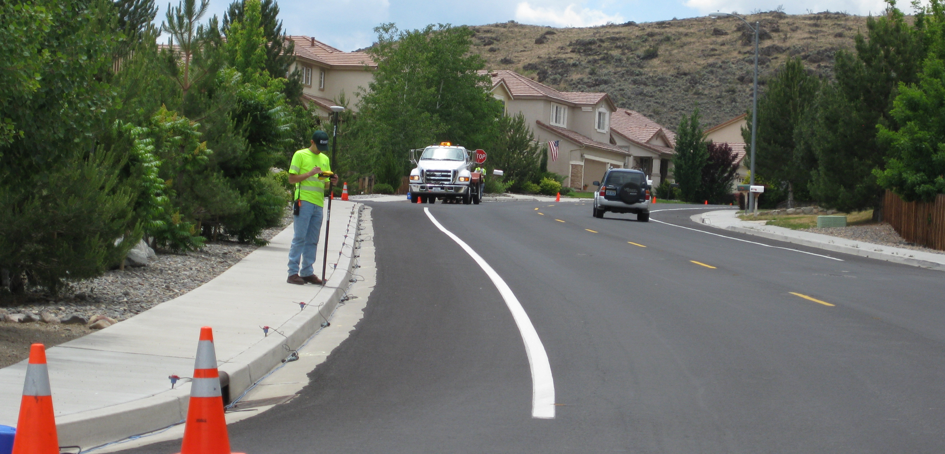

Shallow Seismic Refraction – Unit 3 Part 1: Field data acquisition and instrument setup
Image credit: J. Louie, University of Nevada-Reno

Slide 2
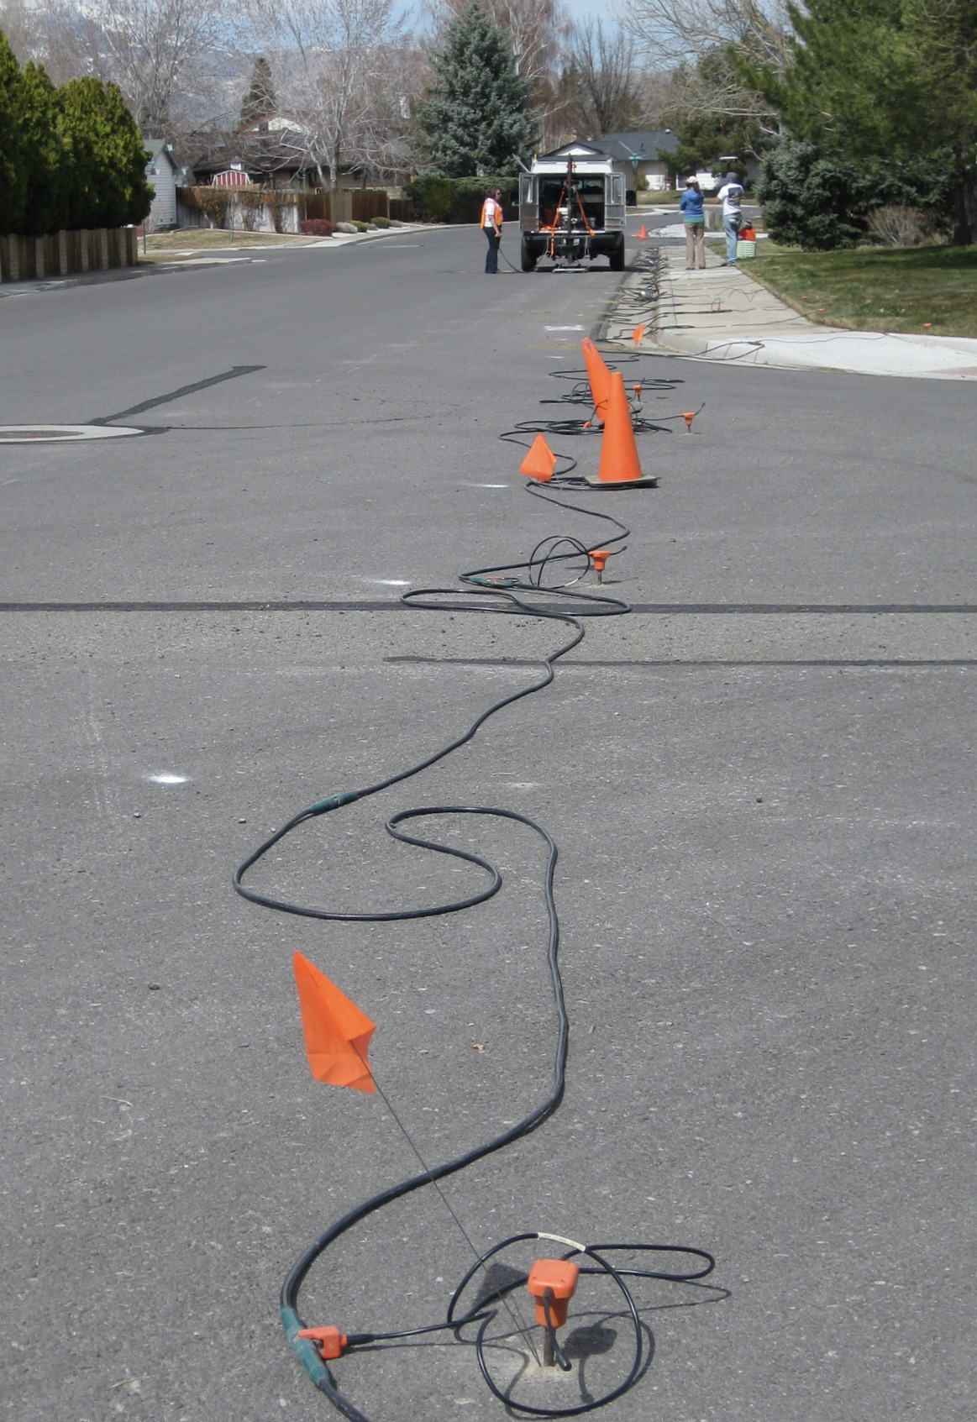
Outline
Setting up the problem: a case study
Data acquisition
parts of the instrument
seismic sources
data recording & geophones
line length and geophone spacing
stacking
where to have shot locations
Making predictions
calculate the instrument parameters you will need
EXERCISE: calculate line length needed for given layer structure
Image credit: J. Louie, University of Nevada-Reno

Slide 3
A problem to be solved using refraction seismology
Case: Bosque Flood Plain Evolution
Problem: Need to know subsurface information to understand how the Bosque ecosystem responds to lower water levels
Question: How deep is water table and flood plain material and what is the strength of material over bedrock?
Reason to use seismic: Able to rapidly evaluate these parameters over a long segment of the corridor along the waterway

Slide 4
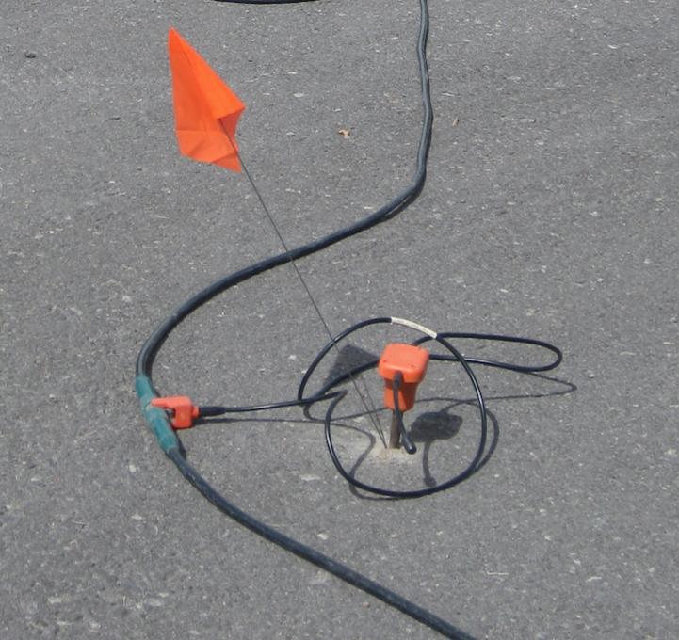
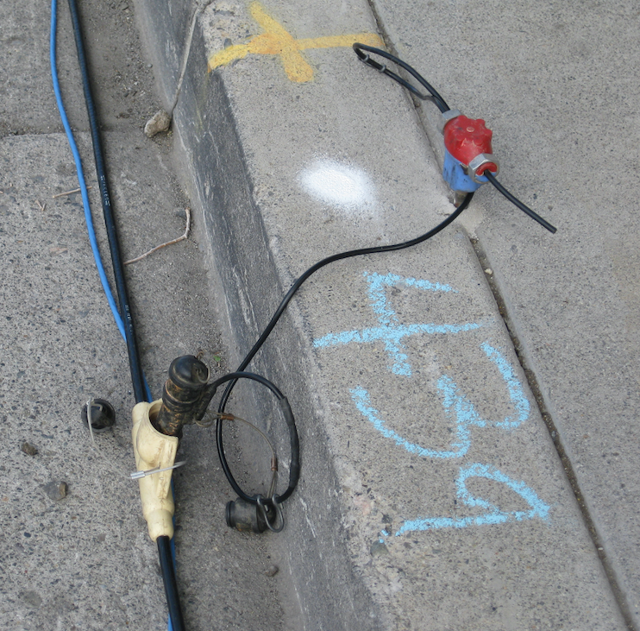
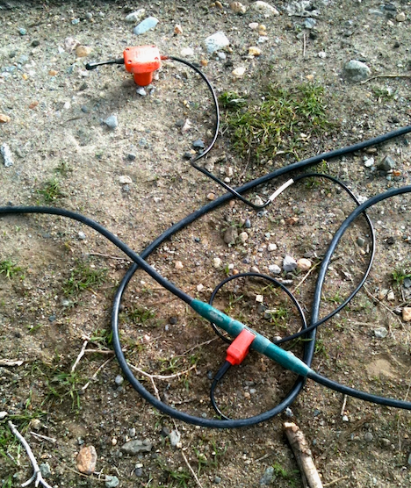
Data acquisition: equipment
Geophones (“receivers”): these are the sensor that converts the seismic vibrations into an electrical impulse that is recorded on the seismograph. They are securely attached to the ground, either by drilling into pavement, finding cracks in concrete, or pushed into soil.
Image credit: J. Louie, University of Nevada-Reno

Slide 5
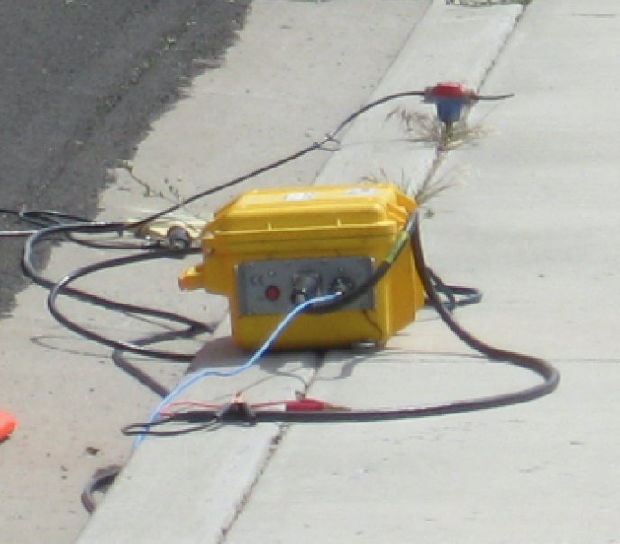
Data acquisition: equipment
Seismograph: This is the part of the instrument that converts the signals from the geophones into data that is sent to a laptop computer. Usually the seismograph is inside a box with cable connectors on the outside, though some seismographs have built-in computers. A seismograph has a set number of channels, or connections available for geophones. You cannot use more geophones than the number of channels your seismograph has available (usually ~24).
Image credit: J. Louie, University of Nevada-Reno

Slide 6
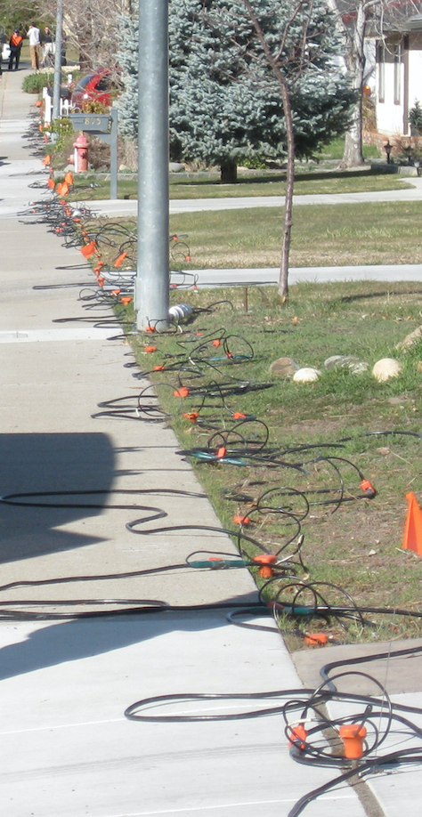
Data acquisition: equipment
Cables: The seismic cables connect each geophone to the seismograph. There are evenly spaced takeouts along the long wires to connect the geophones.
TAKEOUT
TAKEOUT
TAKEOUT
Image credit: J. Louie, University of Nevada-Reno

Slide 7
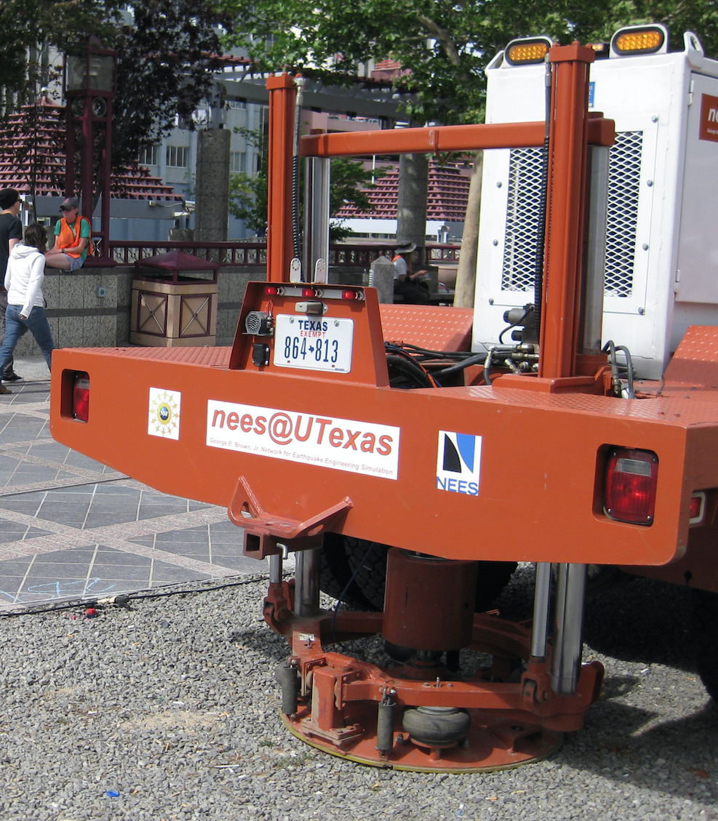
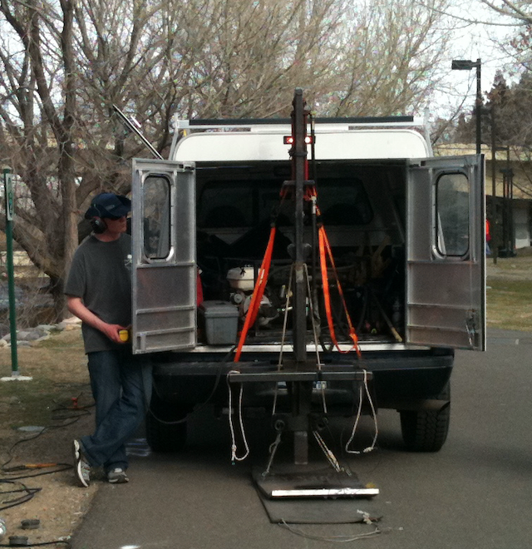
Data acquisition: equipment
Seismic source (“shot”): To generate waves in the ground, some kind of mechanical impulse is used. Most frequently this is a sledge hammer swung by a person to strike a steel plate, or a heavy weight that is dropped with the help of a machine. Special trucks with large vibrating weights are also used as a seismic source.
VIBRO-SEIS
WEIGHT-DROP
SLEDGE HAMMER
Image credit: Andy Parsekian, U. Wyoming
Image credit: J. Louie, University of Nevada-Reno

Slide 8
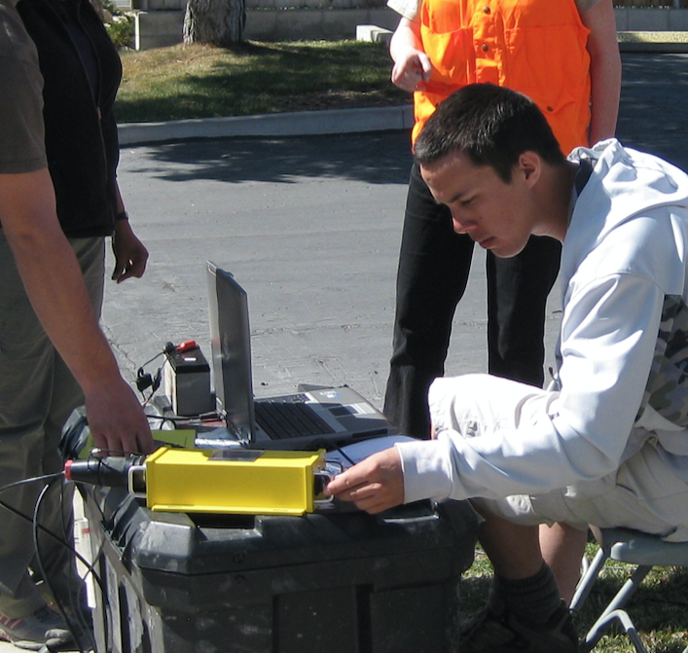
Data acquisition: equipment
Control computer: The seismograph is connected to a computer for overall measurement control and data storage. Surveyors make choices about where the seismic sources are located, where and how geophones are distributed, and how waves are recorded, all based on what kind of data they want to collect.
Image credit: J. Louie, University of Nevada-Reno

Slide 9
Data acquisition: setup
Line length: A common consideration is how long to make the seismic line. These are almost always straight, if possible. This will depend on the subsurface structure and the measurement objective (see Exercise 1 of Unit 3).
Geophone spacing: A related choice is the spacing between geophones. The closer the spacing, the easier it will be to detect thin layers. Often this is very important with the soil on the surface which can be less than one meter thick.
Image credit: J. Louie, University of Nevada-Reno

Slide 10
Data acquisition: setup
Stacking: This is simply a geophysics word that means “repeated measurements.” By repeating the seismic source “shot” – whether it is a hammer strike, weight drop, or something else – it is possible to combine the data from each repetition and produce a dataset with higher signal strength and lower noise.
Image credit: Andy Parsekian, U. Wyoming

Slide 11
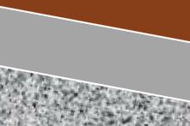

Data acquisition: setup
Shot locations: Once you have set up the geophones on your seismic line, you can make one, two, or many shots on and near the line. ONE shot can give you an estimate of velocity over depth, assuming a horizontally layered subsurface. TWO shots can also allow you to estimate the angle of subsurface layers if they are dipping. Using MANY shots can allow for 2D images to be calculated.
one shot
two shots
Image credit: J. Louie, University of Nevada-Reno

Slide 12
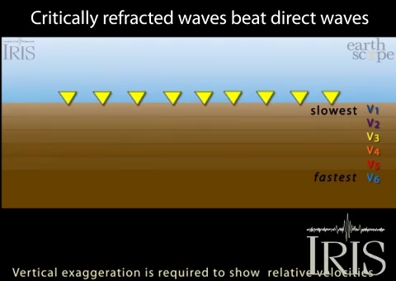
Data acquisition: making predictions
When designing the instrument setup, it is often helpful to make predictions – calculations based on the known or estimated physical behavior – to decide how long of a line to use or how far apart to place geophones. Examples of questions that might be asked are:
How long of a seismic line will be needed to be sure we detect the water table?
What is the required geophone spacing we would need to be sure that the soil layer (direct wave*) is captured by at least 4 geophones?
*This animation shows why the “direct wave” raypath traveling through the soil layer (V₁) may only be detected by the first few geophones.
Animation credit: IRIS

